Slide 1
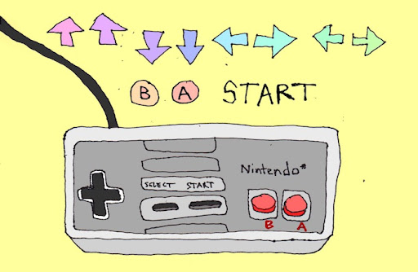
Famous video game cheats
Russell xun
11/15/2021
Citations: http://thefanzine.com/cheating-video-games-moral-imperative/
Notes:
Hello everyone, my name is Russell Xun, I am a cs student here at washu who’s had experiences with cybersecurity and video game development. I will be presenting to you today on some famous video game cheats, a sub-topic of my LFR. How many of you have played video games before? Does this image look familiar to any of you? Great, this is one of the ancient cheat codes that were used in the early Nintendo console games. By quickly typing the cheat code, people were able to gain advantage of the game.

Slide 2
Preview
“Playing a video game is like being in a relationship, everybody cheats”. -Don’t cheat!
Cheat Codes: Konami Code and GTA5 Cheats
Hacked Pokémon
Aim-bots
Notes:
For as long as we’ve had video games, there has always been players who are willing to break the rules in order to win or to gain assets in games. As the gaming industry itself evolves rapidly over decades, cheating methods always find their ways to shatter the market. In today’s presentation, I will be mainly discussing some of the well-known cheats in video games including well-known cheat codes, hacked Pokémon, and aim-bots.

Slide 3

Konami Code: Cheat codes were first made by game developers to make the debugging process much easier
Source: https://www.inkedmag.com/original-news/konami-code
Notes:
Interestingly enough, some of the most iconic cheats were made by the game developers themselves in order to make the debug process much easier. The Konami Code (up, up, down, down, left, right, left, right, B, A, start) is perhaps the most well-known cheat code in gaming history. It was added to 1985's Gradius for the NES by the game's developer, Kazuhisa Hashimoto, who found the game to be too difficult during its debugging phase. He needed to play through the entire game to check for bugs but he couldn't beat the game. Such mechanism enables developers to effectively jump to any point in the game and also saves countless hours of work during testing and debugging

Slide 4
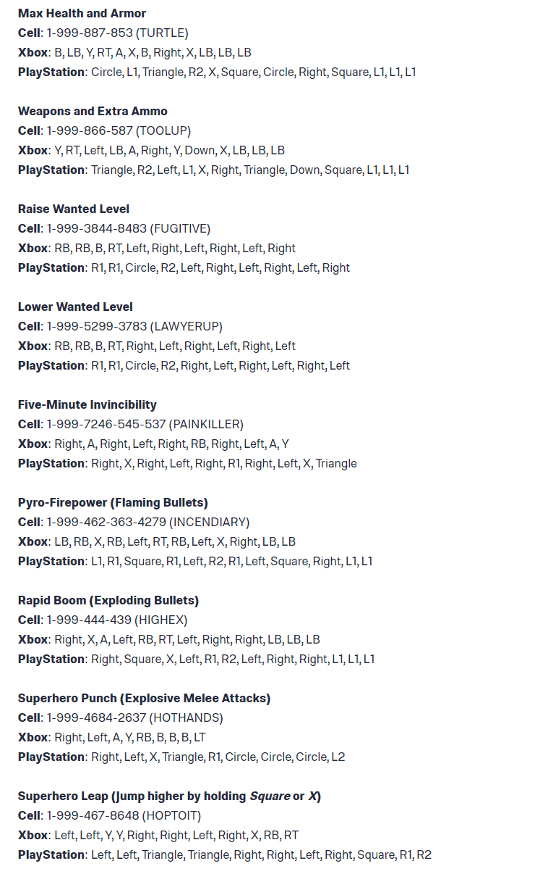
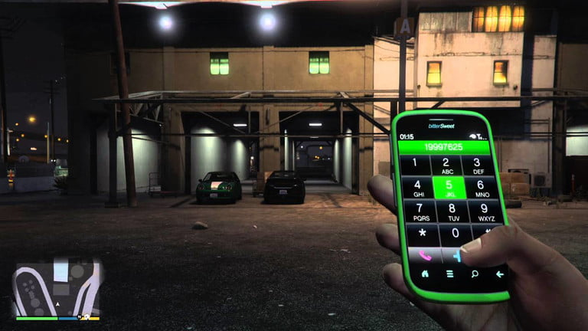
GTA 5 Cheats
Notes:
Cheat codes are also used in Grand Theft Auto 5, one of the bestselling games of all time, an open-world sandbox game created by rockstar. As shown in the figure on the left, there are variety of cheat codes in this game you can use across platforms. One way to enter is to open up the cell phone console in the game and type in the corresponding phone number as shown.

Slide 5
Hacked Pokémon: Devices such as GameShark and Action Replay can be easily used to directly alter the game's data
Notes:
From my personal experience, as a kid, I used to love playing Pokémon on Gameboy. And back then, there was cheating software that allowed players to alternate game statistics such as monsters’ health, getting infinite money, catching Pokémon with 100% certainty, etc. Devices such as GameShark and Action Replay can be easily used to directly alter the game's data in many ways, such as automatically making Pokémon Shiny, giving them optimal IVs and Natures, or even modifying their moves and statistics to obtain otherwise impossible values. These Pokémon are frequently known as hacked Pokémon

Slide 6
Aim-bots
Notes:
Aim-bots, also known as auto-aim, are most commonly used in multiplayer first-person shooter games to provide varying levels of automated target acquisition and calibration to the player. They are sometimes used along with a TriggerBot, which automatically shoots when an opponent appears within the field-of-view or aiming reticule of the player, like an instantaneous reflex. These tools are widely used in First Person Shooter (FPS) games for players to gain unfair advantages over other players. By referring to Aimbots, they are software which is either created to run alongside an FPS, or any number of different modifications to game files that exploit varying aspects of the game code to a player’s advantage.

Slide 8
Works cited
“A Brief History of Cheating at Video Games,” Engadget, accessed January 7, 2021, https://www.engadget.com/2019-06-15-a-brief-history-of-cheating-at-video-games.html.
“Cheating,” Cheating - Bulbapedia, the community-driven Pokémon encyclopedia, accessed January 7, 2021, https://bulbapedia.bulbagarden.net/wiki/Cheating.
“What Are Aimbots and How Do They Work?,” TCQ Review, July 9, 2010, https://tlawlessca.wordpress.com/what-are-aimbots-and-how-do-they-work/.

Slide 9
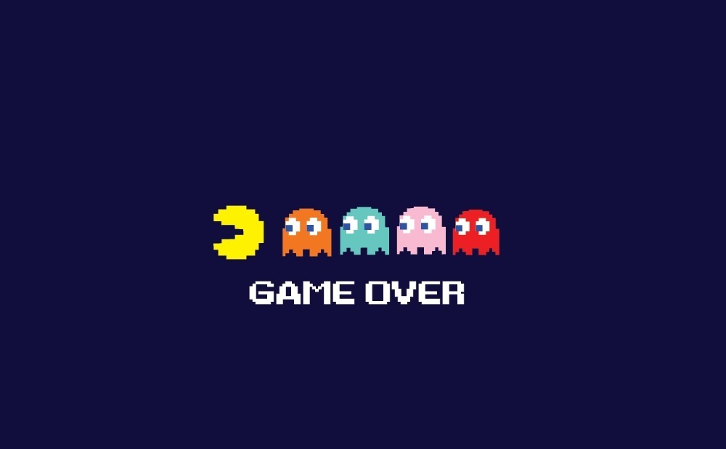
Thank you!

